Slide 1






HEALTH
CARE
MYSǪL

Slide 2

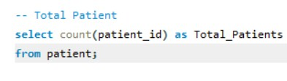



TOTAL PATIENTS

Slide 3




TOTAL DOCTORS

Slide 4



TOTAL VISITS

Slide 5


AVERAGE AGE OF THE PATIENTS

Slide 6
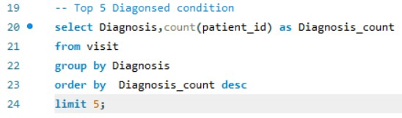
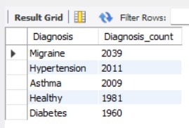
TOP 5 DIAGONSED CONDITION

Slide 7

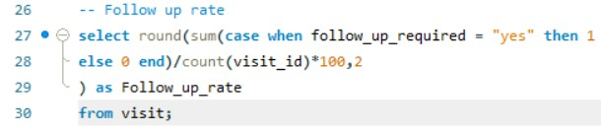

follow-up rate

Slide 8


Average Treatment cost per visit

Slide 9
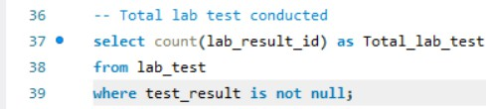

Total lab test conducted

Slide 10
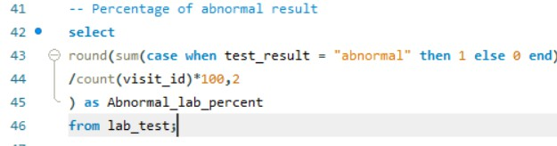

Percentage of abnormal result

Slide 11
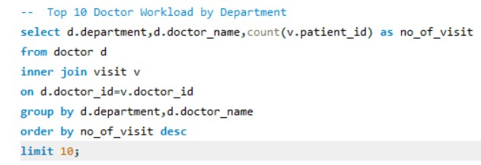
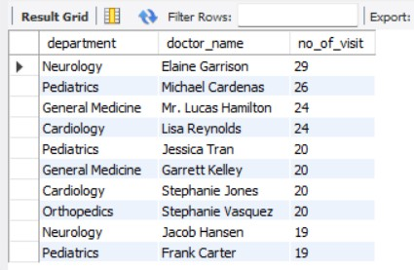
Top 10 Doctor Workload by Department

Slide 12
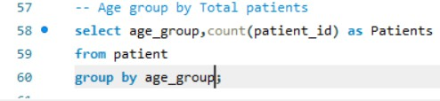
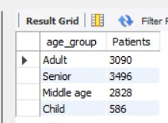
AGE GROUP BY TOTAL PATIENTS

Slide 13



Thank You

